Slide 1

Intro to Truffle
Developed by ConsenSys

Slide 2
What is Truffle?
In general, Truffle is a development environment for
writing,
deploying,
and testing smart contracts for Ethereum.
(This is all very inefficient to do without Truffle)
Notes:
Who is familiar with bash? We will be using your machine specific CLI, I’m not familiar with Windows commands but I think they are for the most part similar to Mac/Linux commands.

Slide 3

Installation
Download/Install Node.js and npm (https://nodejs.org/en/)
Install Truffle
Globally (recommended)
-g a flag to install Truffle globally on your machine
Locally
Make and change to a directory that will hold your project
$ npm install -g truffle
$ npm install truffle
Notes:
Follow the user specific instructions to download node.js (which includes npm)
Depending on your super user permissions, you might need to add the sudo command at the beginning of your command line
To test if node, npm and truffle were installed correctly type which command

Slide 4

Creating Truffle Projects
Make directory for project, unbox MetaCoin truffle box
To initialize default Truffle project
$ mkdir MetaCoin
$ cd MetaCoin
$ truffle unbox metacoin
$ truffle init
Notes:
For the purposes of this talk, we aren’t going to focus on building a smart contract. We’ll use a prebuilt truffle box called MetaCoin to learn the ins and outs of truffle.

Slide 5
Creating Truffle Projects
What did we just create in our project directory?
contracts/
A directory for Solidity contracts (.sol)
migrations/
A directory for JavaScript deployment scripts
test/
A directory for JavaScript test scripts (to test our contracts)
truffle.js
Configuration file for Truffle

Slide 6
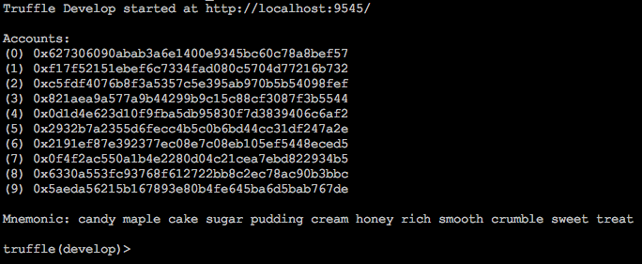
Ethereum Clients: Local
Truffle Develop
Runs on https://127.0.0.1:9545
Runs integrated blockchain and console to run truffle commands
Omit truffle when executing truffle commands
$ truffle develop
Notes:
Starts a Read-Eval-Print Loop or REPL to read truffle commands. Also known as a language shell

Slide 7
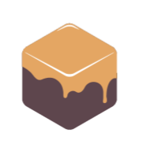

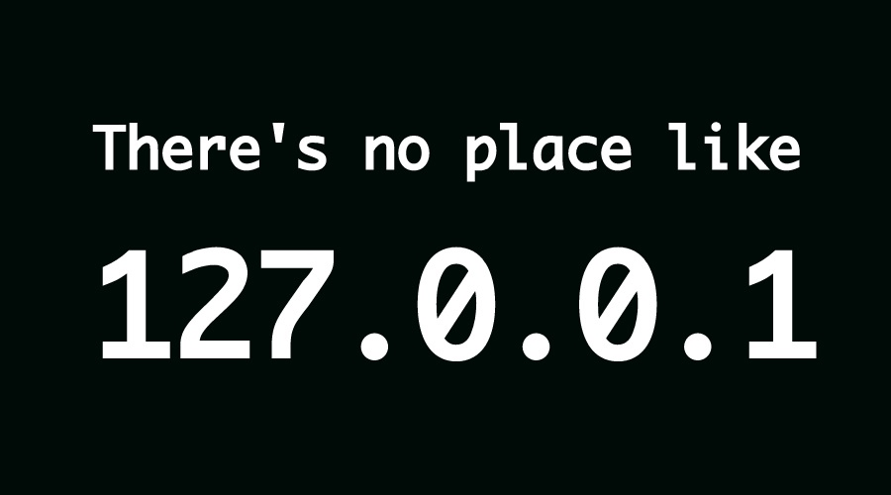
Ethereum Clients: Local
Ganache
Truffle’s integrated personal blockchain
Runs on https://127.0.0.1:7545
JavaScript implementation of the Eth. blockchain
View of accounts, addresses, private keys, tx’s, and balances
Blockchain output log for debugging
Mining controls
Block Explorer
Ganache CLI (formerly known as TestRPC)
Runs on https://127.0.0.1:8545
$ npm install -g ganache-cli
Notes:
module.exports = { networks: { development: { host: "127.0.0.1", port: 8545, network_id: "*" // Match any network id } } };

Slide 8
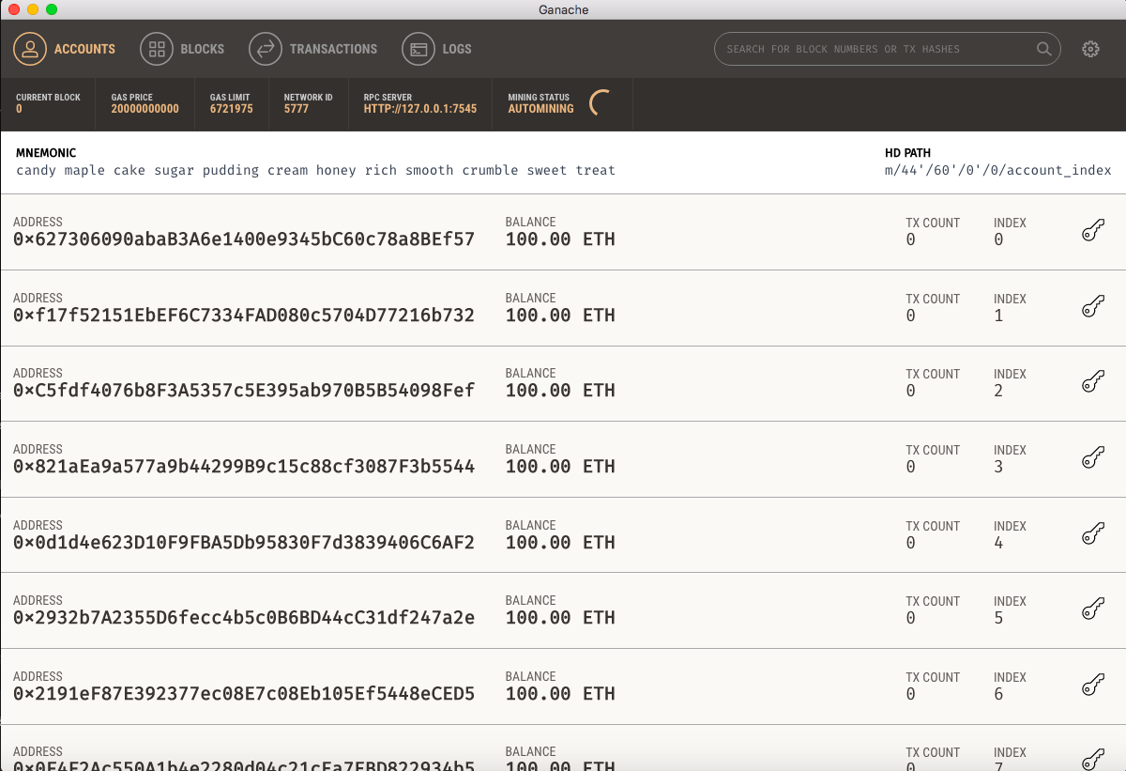

Slide 9

Ethereum Clients: Test Nets
Simulate the EVM
Don’t have to pay for gas to test contracts

Slide 10
Ethereum Clients: Main Net
Welcome to the real world
Is the actual EVM

Slide 11

Compiling Contracts
All contracts located in contracts/
Initialized with a Migrations.sol file to help in the deployment process
To compile, run in project root
Result in build artifacts under build/contracts/
Uses solc package
$ truffle compile
Notes:
Don’t worry about editing the build files, they’ll just be overwritten in the compilation process

Slide 12

Dependencies: Importing Contracts
File importing
Insert import segment in contract (.sol) header
Importing from external packages
Handled through Truffle’s supported package registries : EthPM & NPM
import ./OtherContractName.sol;
import otherpackage/OtherPkgContractName.sol;
Notes:
Who is familiar with libraries or dependencies?
If we want to keep our contracts concise and eliminate redundancy on the blockchain, we call upon libraries to do the work for us.
Show example in MetaCoin.sol import. Imports ConvertLib.sol.
The naive way would be...
Even though only one of our contracts in this example uses the ConvertLib, if we had other contracts that needed to convert, we can just call upon it.

Slide 13



Migrations
JavaScript scripts to assist in deploying contracts
All migration scripts located in migrations/
Migrations.sol isn’t a script for deploying, but logs previous migrations on-chain
Need to have an Ethereum blockchain running (i.e. Ganache)
To migrate, run in project root
Only does anything if new migrations exist
$ truffle migrate
Notes:
Don’t worry if you don’t know any JavaScript, this is quite easy, we’re just connecting the pipeline with these scripts
Go through the migrations/ directory and explain the naming of migration files.
Number prefix is required for confirming migrations runs successfully, everything else after is for documenting certain migration events.
Vim into a migration file
abstract.requires() returns contract abstraction to use in the script. Cannot require a source directory, must require each contract explicitly.
What does the function with the deployer parameter return?

Slide 14
Migrations: Objects
module.exports
Object that aids in mundane deployment tasks
Exports the returned exports object of your deployment function
deployer
Object for staging contracts to be exported and deployed
Similar to staging files for commit on github
Notes:
If you think abstractly as your contracts on your machine existing as a local git repo, they are staged and committed in one step with the deploy function inside of your migration files
These deployment functions can have multiple parameters besides the deployer object

Slide 15
Migrations: deployer
deployer
Staging synchronously
Staging asynchronously (possible to promise chain all deployment staging)
deployer.deploy(A); deployer.deploy(B);
deployer.deploy(A).then(function() { return deployer.deploy(B, A.address); });
Notes:
Through the magic of JavaScript promises, you can create functions that return promises to continues the safely ensure that contracts that other contracts are dependent on the execution of previous contracts.
For example, the deployment of B requires the address of A, perhaps as a constructor argument for B.
deployer.link(libCont, cont[])
Can link a library contract to a single contract or an array of contracts
See the truffle docs API for deployer for the rest of the functionality that comes along with this deployment object

Slide 16
Migrations: Linking
deployer.link(libCont, destCont[])
// Deploy library LibA, then link LibA to contract B, then deploy B. deployer.deploy(LibA); deployer.link(LibA, B); deployer.deploy(B); // Link LibA to many contracts deployer.link(LibA, [B, C, D]);
Notes:
Who is familiar with the term linking?
Why do you think we need linking, why doesn’t the import statement at the top of our contracts do enough?
The import line in our contract was used for what is called the preprocessing phase of compilation which expands our source code to include the definitions of the library files (does not add the library functionality obviously otherwise its redundant on the blockchain)
Normally when we compile something like an executable in C, our executable file is expaned to include the machine code for the functionality of those libraries
So… the linking phase in our migrating script allows our contracts to know where the library contract is on the blockchain when it needs to call it.

Slide 17

Binary Management: ABI
The Application Binary Interface (ABI) determines how to interact with your contract
How functions are called
What binary format data values need to be in
Guarantee what format data is returned as
In the end, the EVM needs machine code
Notes:
What starts with A, ends with I and rhymes with ABI?
The ABI acts like an API so when we call contract functions, we know how and what those functions need.
Provides a way for us to encode into EVM machine code and decode from it as well
Example in MetaCoin.sol
sendCoin function requires 56 bytes to call
The contract signature is the first 4 bytes of a Keccak-256 hash (sn: which I’m assuming is used because it’s almost impossible to get a collision with hashes in your contract with that hash method with more than 4 bill combinations with 4 bytes).
The sendTo address argument that is passed is padded to 20 bytes.
The amount uint (alias for uint256) is well you guessed it 256 bits (32bytes)
32+20+4 = 56
Pq: why is the amount parameter defined as a uint?

